Slide 1
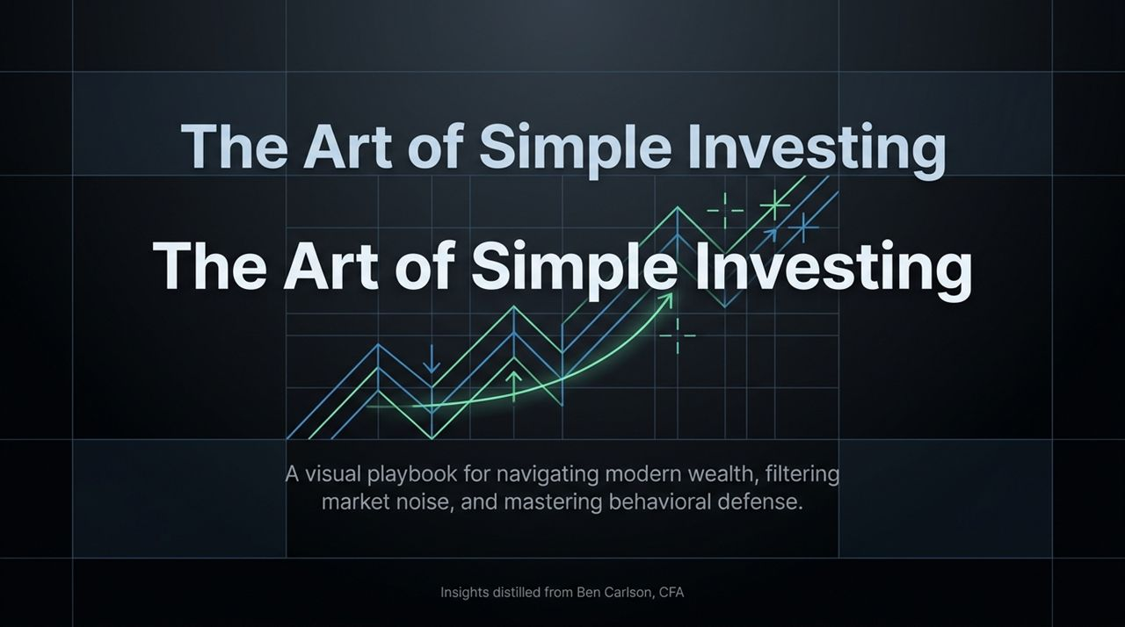
Notes:
Welcome, everyone. Today, we are walking through The Art of Simple Investing, a visual playbook designed to help us navigate modern wealth, filter out the constant noise in today's media environment, and strengthen our behavioral defenses as investors.
The insights in this presentation are distilled directly from Ben Carlson, CFA—author, blogger at A Wealth of Common Sense, and co-host of the Animal Spirits podcast.
When we look at wealth management today, there is a fundamental paradox: technology has given us access to more financial instruments, real-time data, and complex investment strategies than at any point in human history. Yet, the primary factor determining an investor’s long-term success isn’t the complexity of their strategy—it’s their ability to control their behavior, stay disciplined during downturns, and avoid self-inflicted errors.
Over the next 15 slides, we will break down the myth of institutional "secret sauce," explore the reality of public versus private markets, re-examine fixed income and inflation defenses following the market shifts of 2022, and establish clear rules for managing market volatility without sacrificing peace of mind. Let’s dive in.
https://www.youtube.com/watch?v=7AvuMokBeDo

Slide 2
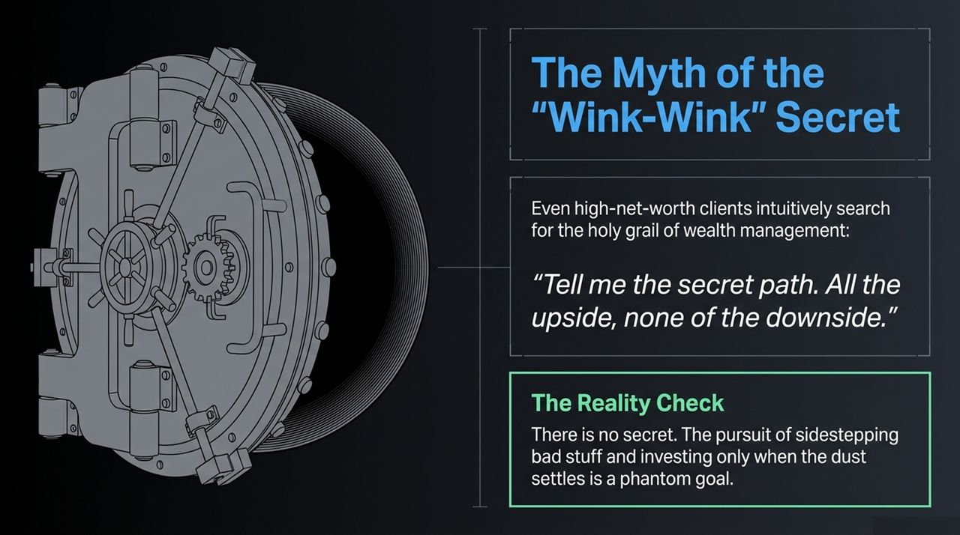
Notes:
Having worked across wealth management and institutional investing, Ben Carlson often points out a common psychological tendency: even ultra-high-net-worth clients intuitively search for a "holy grail" of wealth management.
There is this deep-seated belief that somewhere, behind closed doors, elite investors share a "wink-wink secret path." Clients will literally ask: "Tell me the secret path where I get all of the upside, but none of the downside. How do I sidestep bad market events and jump in only after the dust settles?"
Here is the reality check: There is no secret. The pursuit of sidestepping market pullbacks while capturing all the gains is a phantom goal. In investing, return is explicitly the compensation you receive for taking on risk and enduring uncertainty.
When investors try to eliminate risk entirely through complex structures or market-timing schemes, they usually end up substituting market risk for other risks—such as illiquidity risk, manager risk, opacity risk, and excessive fee drag. The starting point for long-term wealth building is accepting that short-term pain is the price of admission for long-term real gains.

Slide 3
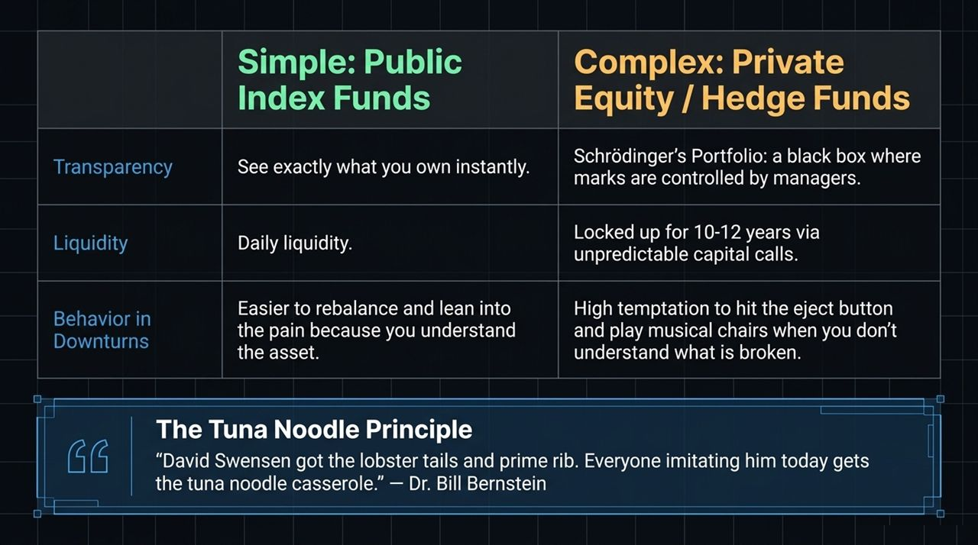
Notes:
This slide contrasts Simple (Public Markets) with Complex (Private Markets) across three key dimensions: Transparency, Liquidity, and Behavior in Downturns.
Transparency: Public index funds allow you to see exactly what you own instantly, marked to market every second the exchanges are open. Complex private equity or hedge funds, by contrast, act like a Schrödinger’s Portfolio. It’s a black box where quarterly asset valuations ("marks") are controlled by the fund managers themselves. You don't truly know what the portfolio is worth until assets are actually sold.
Liquidity: Public markets offer daily liquidity. Private assets require capital lockups often spanning 10 to 12 years, accompanied by unpredictable capital calls where you must supply cash whenever the manager finds an acquisition.
Behavior in Downturns: This is the most crucial takeaway. When a simple public portfolio falls, you understand what you own and why it’s down, making it far easier to rebalance and "lean into the pain." With complex private assets, when performance lags, investors can't evaluate what’s broken. This lack of understanding creates high emotional temptation to hit the eject button and engage in a game of financial musical chairs.

Slide 4
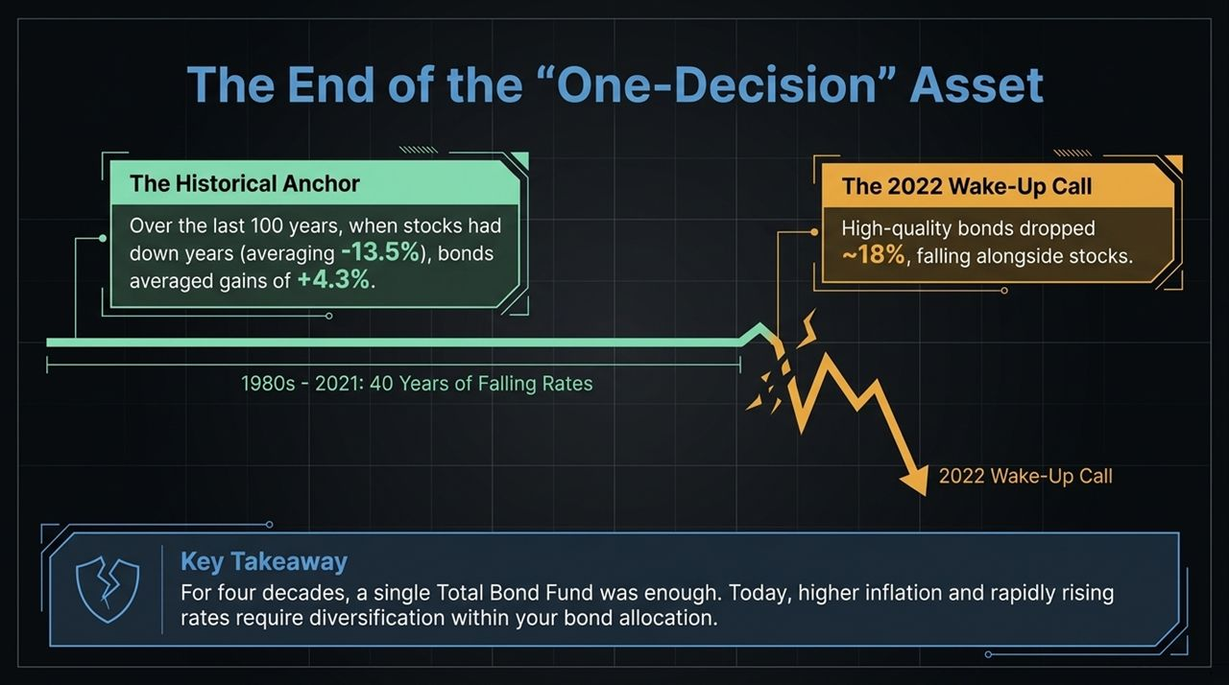
Notes:
To understand why so many investors fall into the complexity trap, we look to a quote from Dr. Bill Bernstein: "David Swensen got the lobster tails and prime rib. Everyone imitating him today gets the tuna noodle casserole."
David Swensen, the legendary late CIO of the Yale University Endowment, pioneered the "Yale Model." He moved Yale's portfolio heavily into illiquid assets, private equity, and venture capital at a time when almost no other institution was doing it. Because he was a pioneer entering an uncrowded market, Yale achieved extraordinary returns.
However, Swensen himself later wrote books advising individual investors not to try to replicate his institutional strategy, recommending broad-based index funds instead. Why? Because the first pioneers at the institutional buffet table got the prime choices. Decades later, as Wall Street financialized these strategies for retail and private client wealth, the high fees, diluted deal quality, and wall of capital competing for private deals mean today's imitators are mostly left with "tuna noodle casserole."

Slide 5
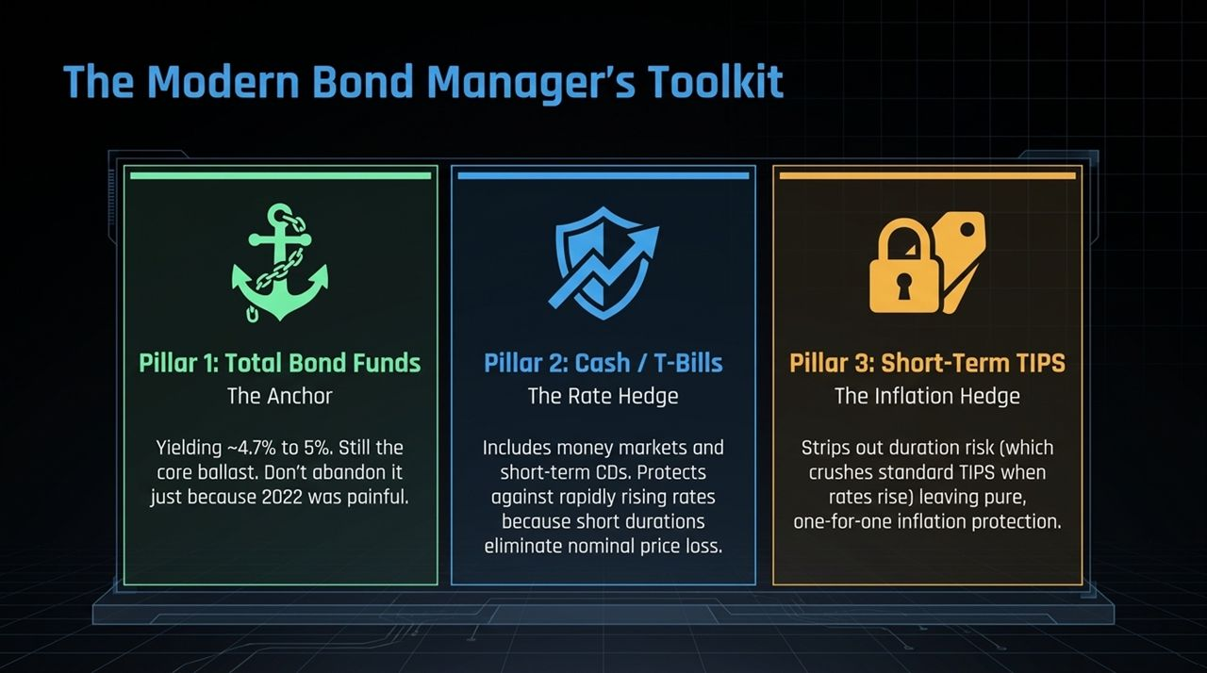
Notes:
For four decades—from the early 1980s through 2021—fixed income was essentially a "one-decision" asset class. Interest rates were on a structural 40-year decline, meaning you could buy a single Total Bond Market Fund and get solid yield, capital appreciation during recessions, and excellent stock diversification.
The Historical Anchor: Over the last century, during years when US stocks posted negative returns (averaging -13.5%), high-quality bonds generated an average gain of +4.3%. Bonds acted as the dependable ballast.
The 2022 Wake-Up Call: 2022 broke that pattern. As inflation surged to 40-year highs, the Federal Reserve raised interest rates at an unprecedented pace. High-quality, intermediate-duration bond funds dropped roughly 18%—falling side-by-side with equities.
Key Takeaway: You cannot assume a single total bond fund will protect you across every economic regime. While bonds remain valuable ballast, higher inflation and rapid rate hikes mean investors now need deliberate diversification within their fixed-income allocation.

Slide 6
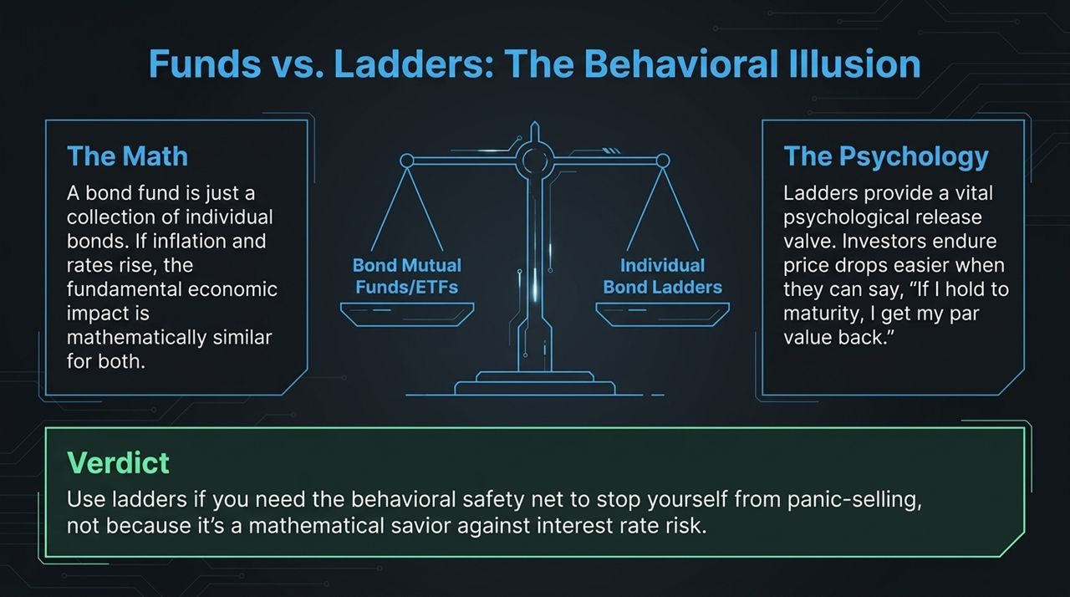
Notes:
To build a resilient fixed-income structure today, we use a three-pillar framework rather than relying on a single total bond fund.
Pillar 1: Total Bond Funds (The Anchor). Yielding in the 4.7% to 5.0% range, intermediate total bond funds remain essential core ballast. Don't abandon them simply because 2022 was painful. If yields fall during a economic slowdown, these funds provide critical duration gains.
Pillar 2: Cash & T-Bills (The Rate Hedge). Money market funds, short-duration Treasury bills, and CDs eliminate nominal price risk because their ultra-short duration allows yields to adjust rapidly as the Fed hikes rates.
Pillar 3: Short-Term TIPS (The Inflation Hedge). Standard Treasury Inflation-Protected Securities (TIPS) suffered in 2022 because long duration offset their inflation adjustments. Short-term TIPS strip out that duration risk, providing direct, one-for-one inflation adjustments without price volatility from rising rates.

Slide 7
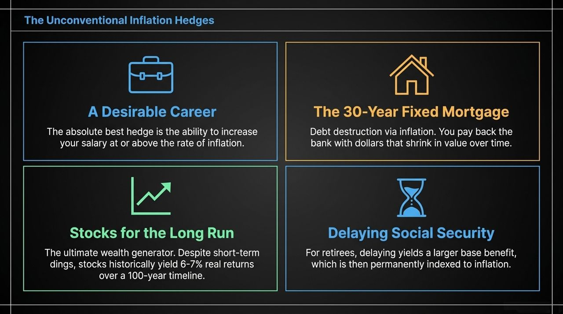
Notes:
There is a ongoing debate among individual investors regarding Bond Mutual Funds/ETFs versus Individual Bond Ladders.
The Math: Mathematically, a bond fund is simply a portfolio of individual bonds held to a target duration. If market interest rates rise, the underlying economic loss of purchasing power and price drop is virtually identical whether you hold the fund or the individual bonds.
The Psychology: Psychologically, however, individual ladders offer a powerful mental release valve. When a bond fund's ticker shows a paper drop, investors panic. But with an individual bond ladder, investors comfortably tell themselves, "As long as I hold this to maturity, I will get my principal back at par."
Verdict: Use individual bond ladders if you require that behavioral safety net to prevent yourself from panic-selling during rising-rate cycles—not because it offers a mathematical edge over funds.

Slide 8
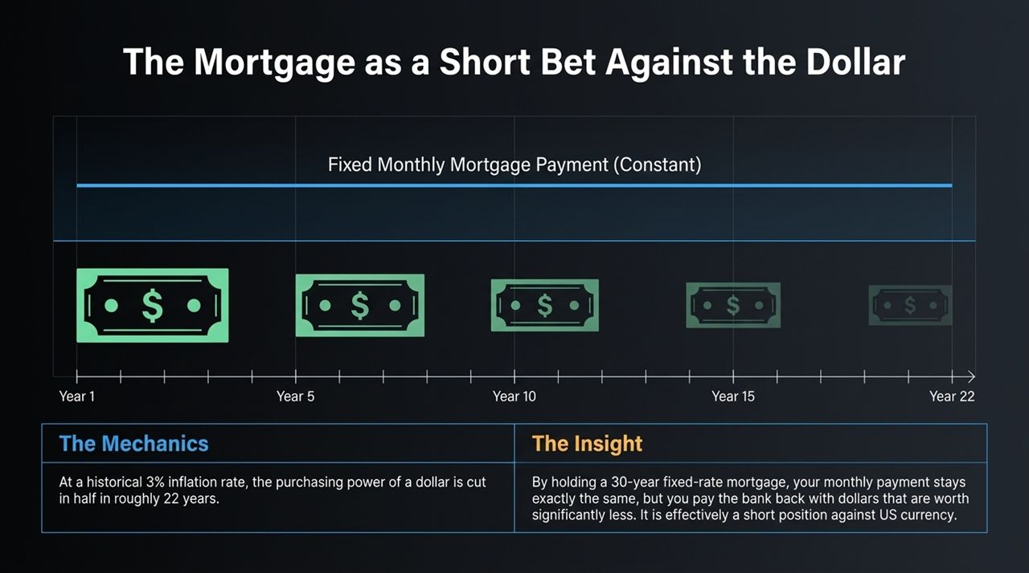
Notes:
When investors worry about inflation, they often look for financial products like gold, commodities, or crypto. However, Ben Carlson emphasizes four real-world household Hedges:
A Desirable Career: The single strongest inflation defense is your own human capital—the ongoing ability to increase your salary at or above the rate of inflation.
The 30-Year Fixed Mortgage: A fixed-rate mortgage allows you to lock in housing costs while paying back bank debt using dollars that shrink in purchasing power over time.
Stocks for the Long Run: Public equities represent real businesses that can adjust prices to keep pace with inflation. Despite short-term turbulence during inflation spikes, equities historically yield 6% to 7% real (after-inflation) returns over multi-decade horizons.
Delaying Social Security: For retirees, delaying benefits increases the monthly baseline payout, which is then permanently indexed to CPI.

Slide 9
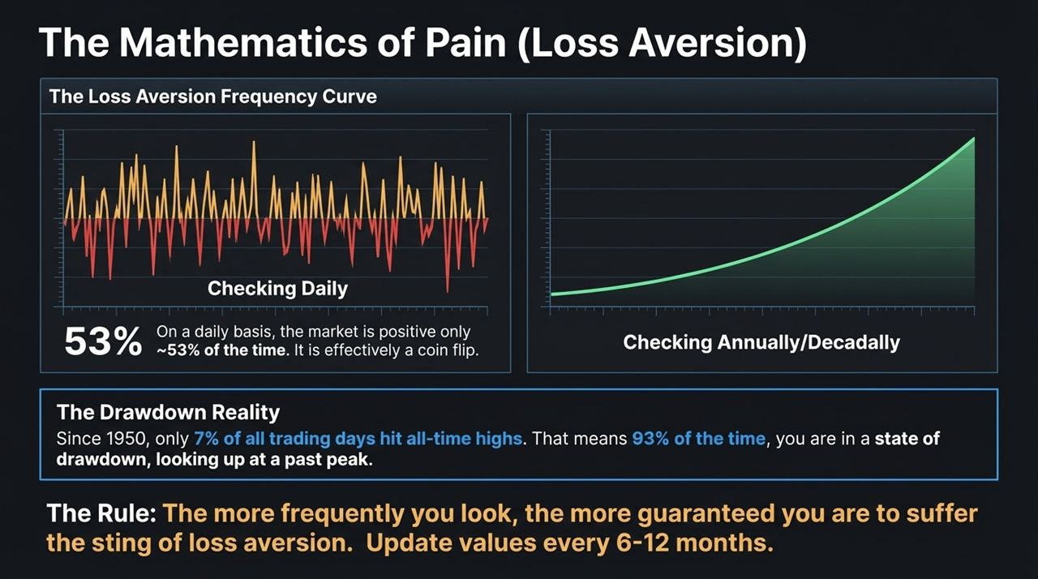
Notes:
Expanding on the mortgage concept, holding a 30-year fixed-rate debt position is structured like a short bet against the purchasing power of the US dollar.
The Mechanics: Even at a modest historical inflation rate of 3% per year, the purchasing power of a paper dollar is reduced by approximately half every 22 years.
The Insight: While inflation erodes the value of held cash, a fixed-rate mortgage locks your nominal monthly housing payment flat over 30 years. As wages and prices rise around you over time, the real economic weight of that monthly mortgage payment shrinks significantly. You are effectively repaying fixed nominal debt with cheaper, inflated currency.

Slide 10
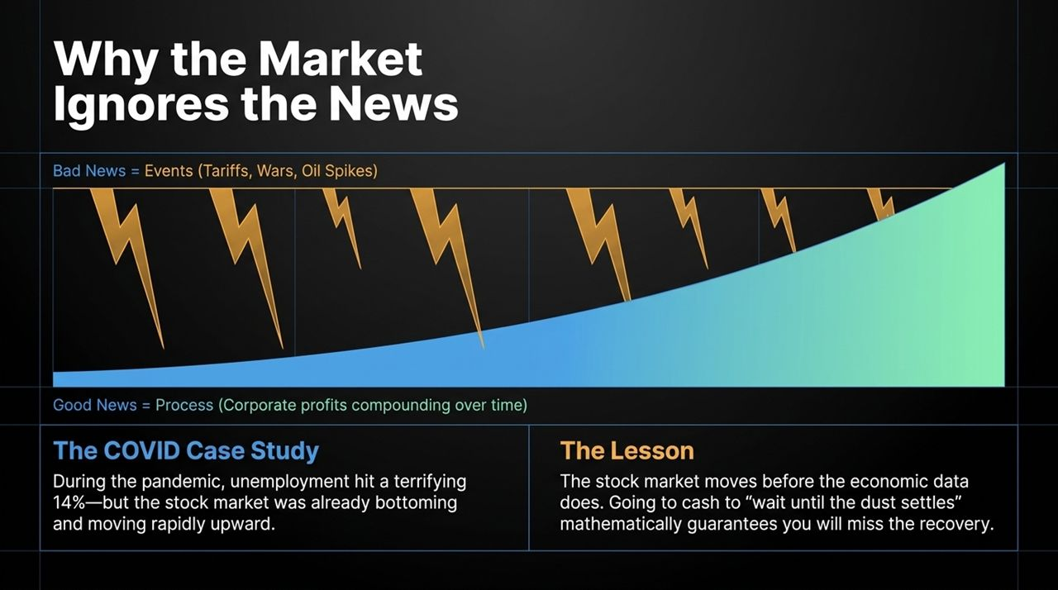
Notes:
Behavioral finance shows that human beings feel the emotional pain of a financial loss roughly twice as intensely as the pleasure of an equivalent gain. This slide illustrates how account-checking frequency triggers that loss aversion.
Checking Daily: On any single trading day, the stock market is positive roughly 53% of the time. Checking your portfolio daily is effectively flipping a coin, exposing you to negative emotional feedback nearly half the days.
The Drawdown Reality: Since 1950, only 7% of all trading days closed at a new all-time high. That means 93% of the time, your portfolio sits below its historical peak.
The Rule: The more frequently you look at your portfolio values, the more frequently you experience loss aversion. To preserve behavioral discipline, limit formal account updates to every 6 to 12 months.

Slide 11
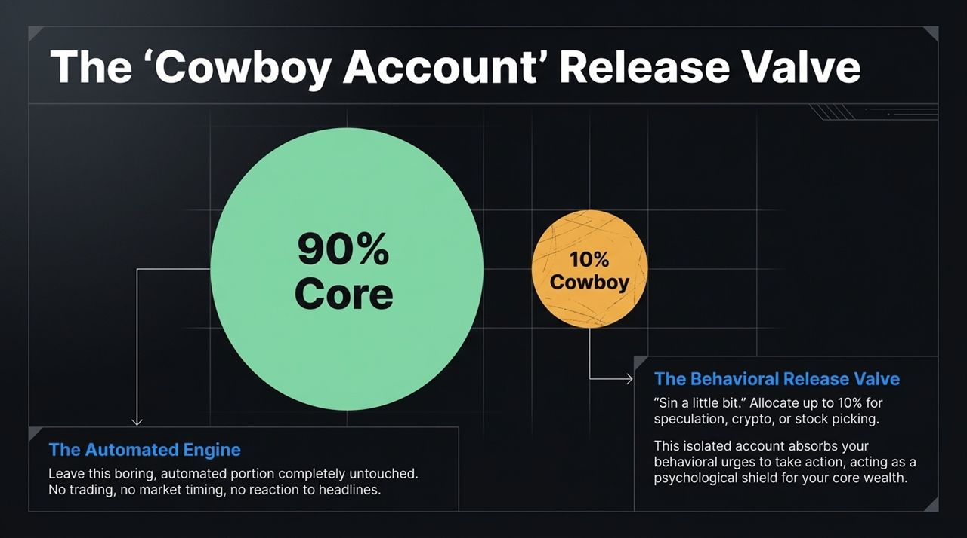
Notes:
A major pitfall for individual investors is trying to trade portfolios based on breaking news headlines.
Bad News is an Event; Good News is a Process: Bad news arrives as sudden events—tariffs, geopolitical conflict, oil shocks, or earnings misses. Good news, by contrast, is an ongoing, quiet compounding process driven by business innovation, earnings productivity, and reinvested dividends over time.
The COVID Case Study: In early 2020, as COVID spread, US unemployment spiked to a record 14%. Yet, right as economic data reached its worst levels in spring 2020, the stock market bottomed and surged upward.
The Lesson: Markets are forward-looking engines that price in events before official economic figures appear. Exiting to cash to "wait until the dust settles" guarantees you miss the sharpest points of market recovery.

Slide 12
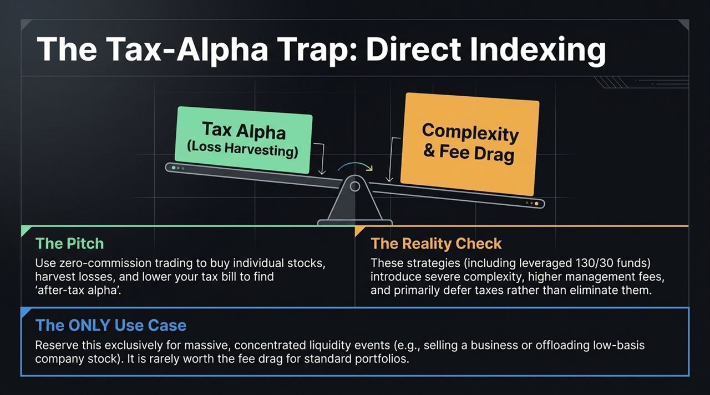
Notes:
Recognizing that strict self-discipline can be difficult to maintain, Ben Carlson suggests introducing a behavioral release valve using a 90/10 split:
90% Core Engine: The bulk of your wealth is committed to an automated, low-cost index portfolio. It remains completely untouched by headlines, emotion, or market timing.
10% Cowboy Account: Up to 10% of your capital is isolated in a separate account dedicated to individual stock picking, tactical bets, or speculative assets.
This setup allows you to "sin a little bit" in a controlled space. By isolating your speculative urges to a small fraction of your portfolio, you protect your core long-term wealth from behavioral mistakes.

Slide 13
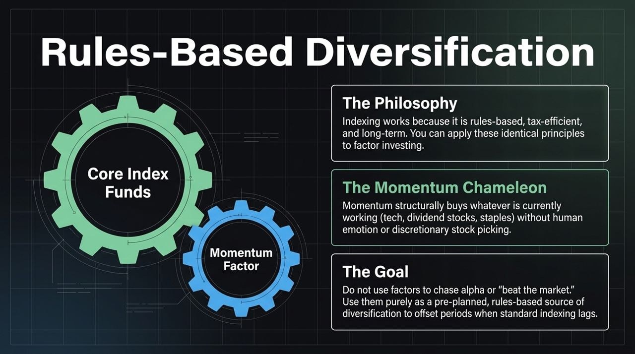
Notes:
In recent years, wealth managers have increasingly promoted Direct Indexing as a way to generate "after-tax alpha."
The Pitch: Instead of holding an ETF, you purchase hundreds of individual stocks directly via fractional shares, continuously harvesting losses to offset realized capital gains elsewhere. Advanced versions even add leverage (e.g., 130/30 long-short structures) to amplify loss harvesting opportunities.
The Reality Check: These strategies introduce considerable complexity, tracking error, and ongoing management fees. Furthermore, loss harvesting primarily defers taxes rather than eliminating them entirely.
The ONLY Use Case: Direct indexing is generally best reserved for specific liquidity events—such as selling a business or unwinding low-basis concentrated stock positions. For standard portfolio accumulation, the added management fees and complexity often outweigh the net tax benefits.

Slide 14
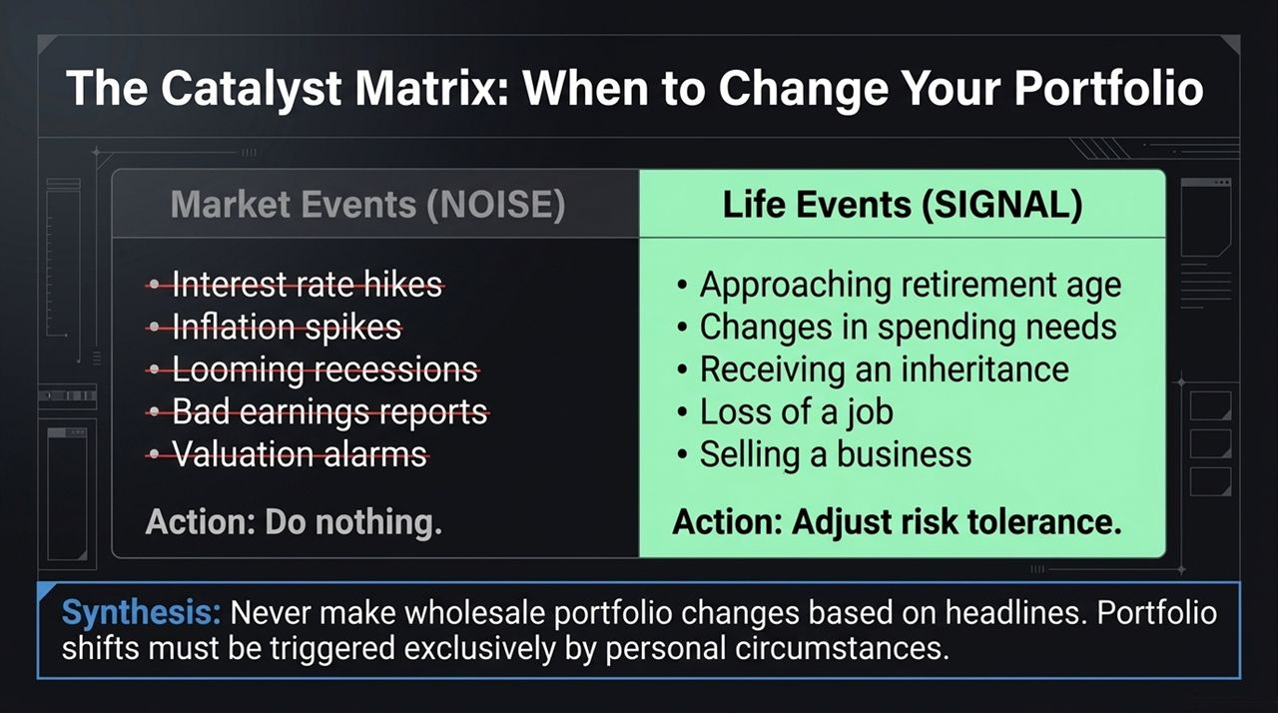
Notes:
If you choose to move beyond market-cap indexing, it should be done through rules-based factor strategies rather than discretionary stock picking.
The Philosophy: Broad market indexing works because it operates on systematic rules, maintaining low turnover and high tax efficiency. You can apply these same systematic principles to factor strategies like Momentum.
The Momentum Chameleon: A momentum strategy systematically buys assets displaying strong recent performance—whether tech, energy, or consumer staples—without relying on human forecasting or emotional biases.
The Goal: Factor exposure should not be treated as a quest for market-beating "alpha." Instead, view it as a pre-planned source of structural diversification designed to support performance during periods when standard market-cap indexing lags.

Slide 15
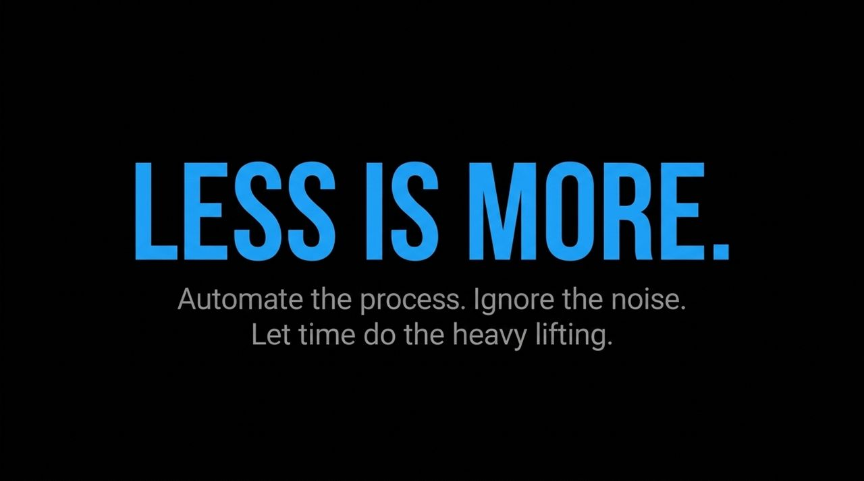
Notes:
This matrix establishes clear boundaries between market noise and true portfolio triggers.
Market Events (NOISE): Rate changes, inflation reports, recessions, corporate earnings, and valuation alarms represent market noise. Action: Do nothing. Never alter your core allocation based on news headlines.
Life Events (SIGNAL): Approaching retirement, shifts in spending, receiving an inheritance, job loss, or selling a business represent real lifestyle signals. Action: Adjust risk tolerance.
Synthesis: Market headlines should never trigger wholesale allocation changes. Portfolio shifts should be driven strictly by changes in your personal financial circumstances and timeline.

Slide 16
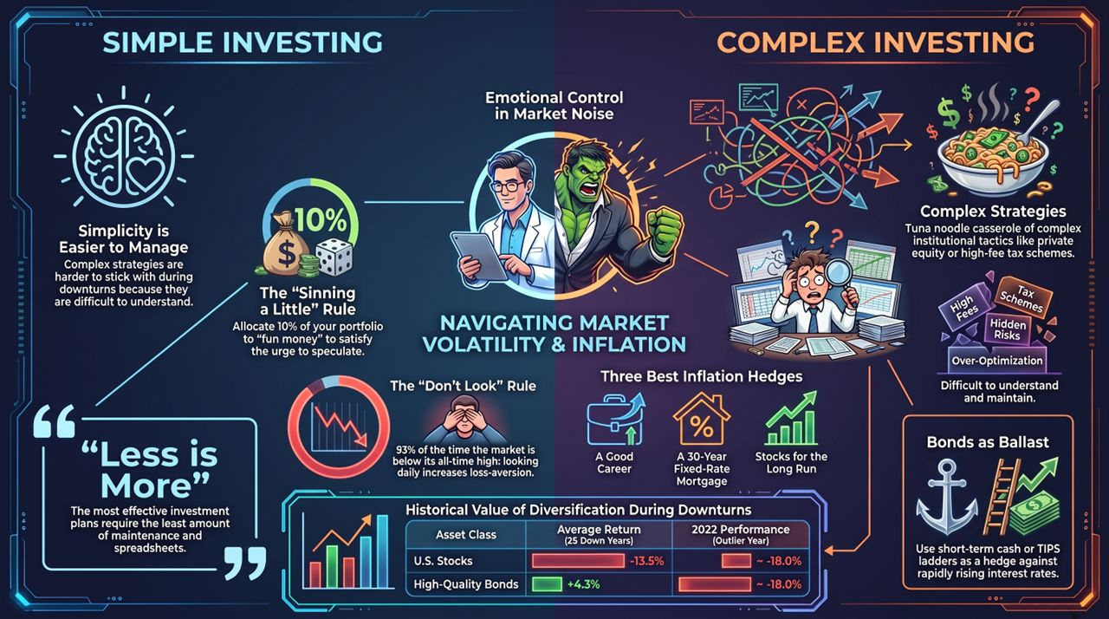
Notes:
To conclude: Less is More. Automate your process, tune out daily headlines, and let time compound your wealth.
Simplicity is Easier to Maintain: Complex strategies are often abandoned during market panics because they are difficult to evaluate.
Maintain Behavioral Guards: Use the "Don't Look" rule (checking accounts every 6–12 months) to limit loss aversion, and use a 10% "Cowboy Account" if you need a speculative outlet.
Structure Fixed Income Deliberately: Maintain core total bond funds for ballast, complemented by short-term cash or TIPS to hedge against inflation and rising interest rates.
Rely on Real Inflation Hedges: Focus on growing your career earnings, holding long-term equities, and leveraging fixed-rate housing debt.
Stick to simple, rules-based strategies, align changes with your life goals, and let compounding do the heavy lifting. Thank you!

